Slide 1
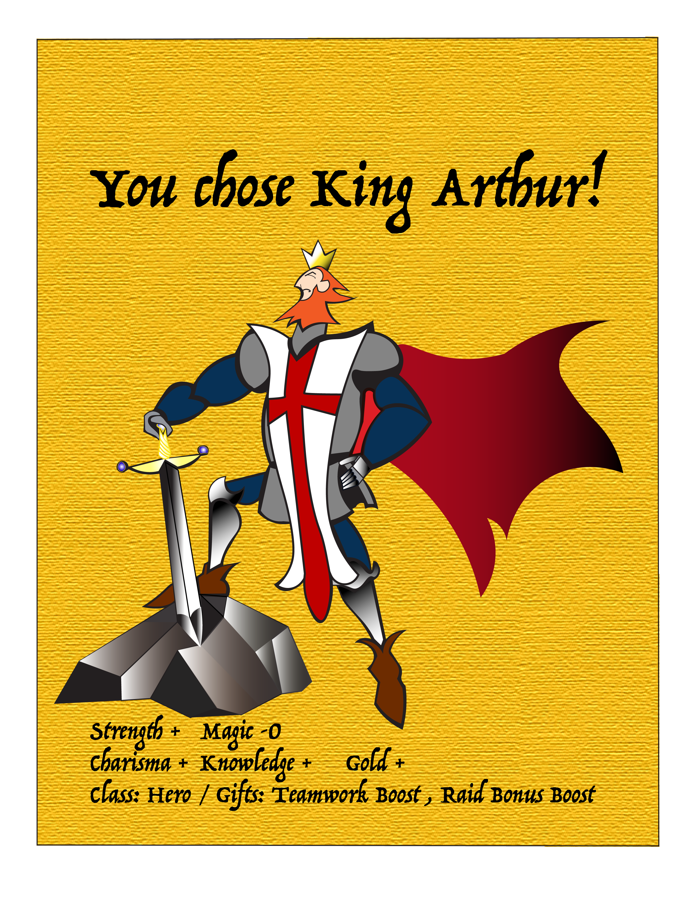
Fairy Tell Tales A Social Network for Gamers
Raquel
Fernandez
Jonathan
Morris
Eric
Santiago
William
Willaims

Slide 2
Our Mission
Connect players of all ages to immerse into Role-play gaming through folkloric story-telling and legends.
Where in the World is Carmen Santiago and World of Warcraft…for the Silent and Baby-boomer generation. (ages 50 and up)
Discover and learn about diverse cultures and their legends. Be on the side of the demi-god Hercules or Hades, God of the Underworld!
Create a safe environment for players new to Role-Playing Games in a subscription pack.
You can play as the Hero or Villain by completing the quests given by NPC or the Quest Givers who are based on folktales, cryptozoology, or mythology.

Slide 3
Pick a Continent
^Hero ^
v Villain v
Quest Item #1
Quest Item #2
Quest Item #3
Quest Item #1
Quest Item #2
Quest Item #3
You ‘re a Hero!
You’re a Villain!
Travel to add more continents to map!
Travel to add more continents to map!
Shop or Sell goods in the global market
Shop or Sell quest items in the global market
Raid other camps for more gold and goods
Raid other camps for more gold and goals
Pick a character from the roster
Gameplay

Slide 4
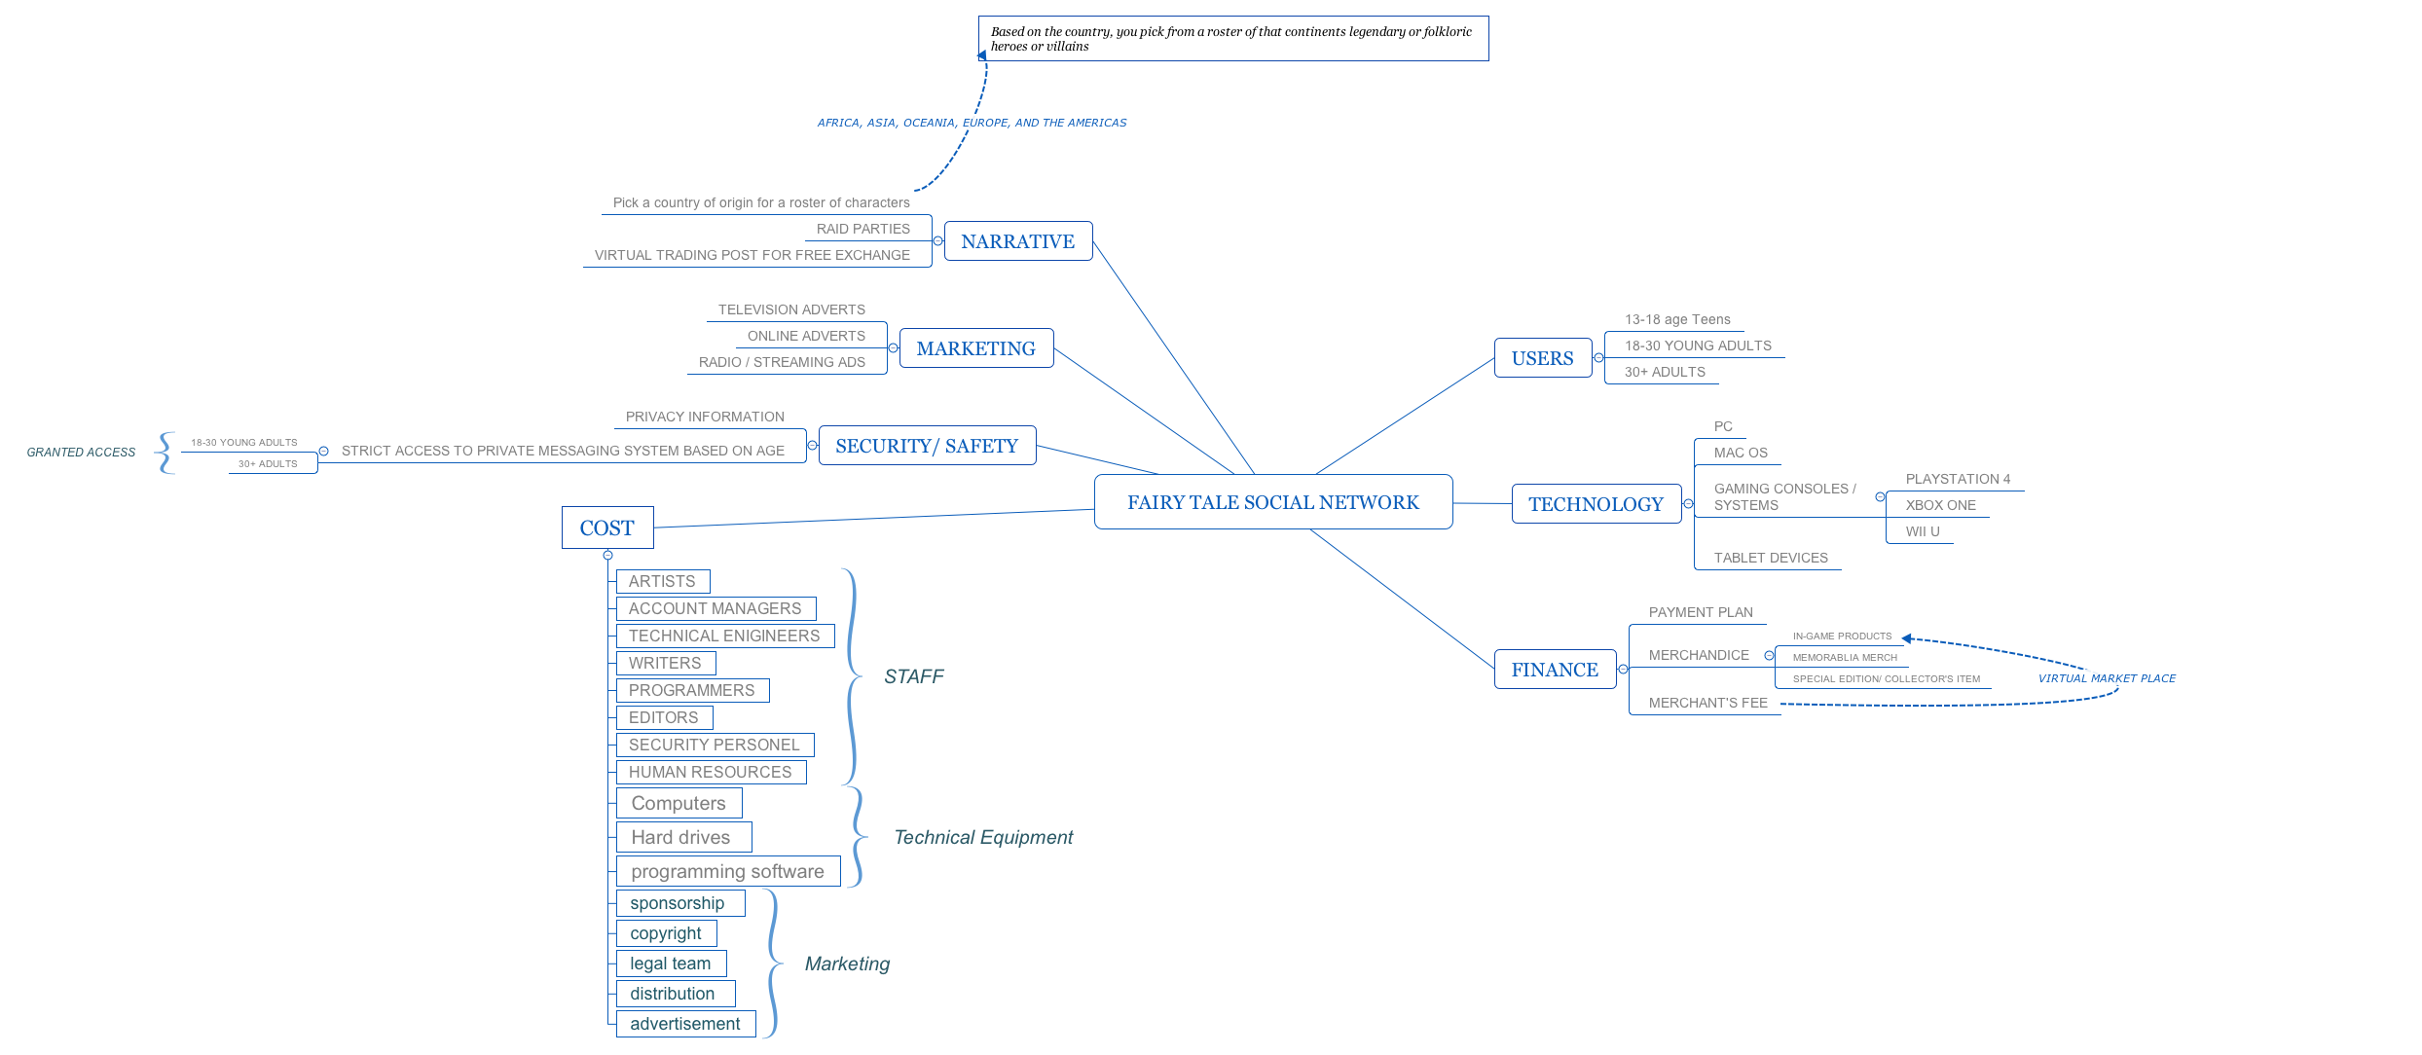
Lab One: Mind Map

Slide 5
Stakeholders
Project Manager
Raquel F,
Writer and Editor
Jonathan M. and Raquel. F
Artists
Raquel F. and Eric S.
Animators
Accounts
Marketing
Research
Producer
Programmers
Will Williams
Eric S.
Notes:
Project Manager
Raquel Fernandez – Oversees production in each department. Cooperates with teammates so to
Writer – Brainstorms ideas with creative integrity.
Jonathan Morris
Visual development – Designs characters and Environments through Conceptual planning up to the closing
Eric Santiago
William Williams
Raquel Fernandez
Programmers – Constructs virtual interface for the platform(s).
William Williams
Eric Santiago
Accounts – Monitors project budget and calculates spending.
Producer – Will find sponsorship

Slide 6
If you choose to be a Villain… Collect the quest items for reputation points!
Hero
Item^
Item^
Villain
Item v
Item v
Item v
Item^
Notes:
Prototype
Project Manager
Raquel Fernandez – Oversees production in each department. Cooperates with teammates so to
Writer – Brainstorms ideas with creative integrity.
Jonathan Morris
Visual development – Designs characters and Environments through Conceptual planning up to the closing
Eric Santiago
William Williams
Raquel Fernandez
Programmers – Constructs virtual interface for the platform(s).
William Williams
Eric Santiago
Accounts – Monitors project budget and calculates spending.
Producer – Will find sponsorship
Oversees production each department
Brainstorms ideas and creative integrity
Design characters and environments through conceptual planning before the final looks
Engineers

Slide 7
Hero
Item
Item
Villain
Item
Item
Item
Notes:
Project Manager
Raquel Fernandez – Oversees production in each department. Cooperates with teammates so to
Writer – Brainstorms ideas with creative integrity.
Jonathan Morris
Visual development – Designs characters and Environments through Conceptual planning up to the closing
Eric Santiago
William Williams
Raquel Fernandez
Programmers – Constructs virtual interface for the platform(s).
William Williams
Eric Santiago
Accounts – Monitors project budget and calculates spending.
Producer – Will find sponsorship
Oversees production each department
Brainstorms ideas and creative integrity
Design characters and environments through conceptual planning before the final looks
Engineers

Slide 8
Hero
Item
Item
Villain
Item
Item
Notes:
Project Manager
Raquel Fernandez – Oversees production in each department. Cooperates with teammates so to
Writer – Brainstorms ideas with creative integrity.
Jonathan Morris
Visual development – Designs characters and Environments through Conceptual planning up to the closing
Eric Santiago
William Williams
Raquel Fernandez
Programmers – Constructs virtual interface for the platform(s).
William Williams
Eric Santiago
Accounts – Monitors project budget and calculates spending.
Producer – Will find sponsorship
Oversees production each department
Brainstorms ideas and creative integrity
Design characters and environments through conceptual planning before the final looks
Engineers

Slide 9
Congratulations! You’re a Villain!
Notes:
Project Manager
Raquel Fernandez – Oversees production in each department. Cooperates with teammates so to
Writer – Brainstorms ideas with creative integrity.
Jonathan Morris
Visual development – Designs characters and Environments through Conceptual planning up to the closing
Eric Santiago
William Williams
Raquel Fernandez
Programmers – Constructs virtual interface for the platform(s).
William Williams
Eric Santiago
Accounts – Monitors project budget and calculates spending.
Producer – Will find sponsorship
Oversees production each department
Brainstorms ideas and creative integrity
Design characters and environments through conceptual planning before the final looks
Engineers

Slide 10
If you choose to be a Hero…
Hero
Item^
Item^
Villain
Item v
Item v
Item v
Item^
Notes:
Project Manager
Raquel Fernandez – Oversees production in each department. Cooperates with teammates so to
Writer – Brainstorms ideas with creative integrity.
Jonathan Morris
Visual development – Designs characters and Environments through Conceptual planning up to the closing
Eric Santiago
William Williams
Raquel Fernandez
Programmers – Constructs virtual interface for the platform(s).
William Williams
Eric Santiago
Accounts – Monitors project budget and calculates spending.
Producer – Will find sponsorship
Oversees production each department
Brainstorms ideas and creative integrity
Design characters and environments through conceptual planning before the final looks
Engineers

Slide 11
Hero
Item
Item
Villain
Item
Item
Item
Notes:
Project Manager
Raquel Fernandez – Oversees production in each department. Cooperates with teammates so to
Writer – Brainstorms ideas with creative integrity.
Jonathan Morris
Visual development – Designs characters and Environments through Conceptual planning up to the closing
Eric Santiago
William Williams
Raquel Fernandez
Programmers – Constructs virtual interface for the platform(s).
William Williams
Eric Santiago
Accounts – Monitors project budget and calculates spending.
Producer – Will find sponsorship
Oversees production each department
Brainstorms ideas and creative integrity
Design characters and environments through conceptual planning before the final looks
Engineers

Slide 12
Hero
Item
Villain
Item
Item
Item
Notes:
Project Manager
Raquel Fernandez – Oversees production in each department. Cooperates with teammates so to
Writer – Brainstorms ideas with creative integrity.
Jonathan Morris
Visual development – Designs characters and Environments through Conceptual planning up to the closing
Eric Santiago
William Williams
Raquel Fernandez
Programmers – Constructs virtual interface for the platform(s).
William Williams
Eric Santiago
Accounts – Monitors project budget and calculates spending.
Producer – Will find sponsorship
Oversees production each department
Brainstorms ideas and creative integrity
Design characters and environments through conceptual planning before the final looks
Engineers

Slide 13
Congratulations! You’re a Hero!
Notes:
Project Manager
Raquel Fernandez – Oversees production in each department. Cooperates with teammates so to
Writer – Brainstorms ideas with creative integrity.
Jonathan Morris
Visual development – Designs characters and Environments through Conceptual planning up to the closing
Eric Santiago
William Williams
Raquel Fernandez
Programmers – Constructs virtual interface for the platform(s).
William Williams
Eric Santiago
Accounts – Monitors project budget and calculates spending.
Producer – Will find sponsorship
Oversees production each department
Brainstorms ideas and creative integrity
Design characters and environments through conceptual planning before the final looks
Engineers

Slide 14
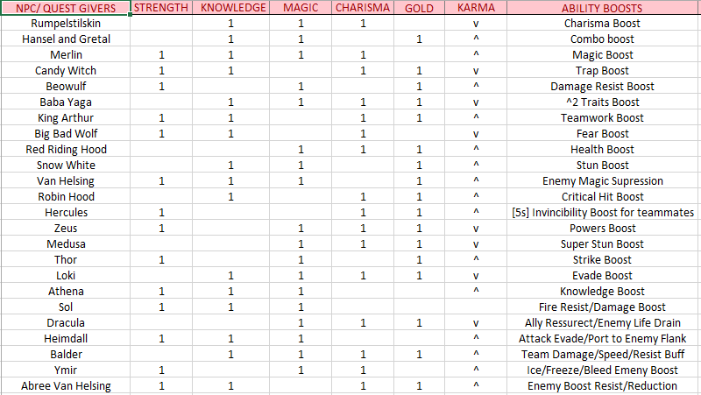
Quest Giver Roster: If you pick Europe…

Slide 15

Target Audience
Pre-Teens 9-12 | Teens 13-18 | Adults 19-60 | Senior 60-90

Slide 16
Technology
Mac/PC for work and play.
Smart devices – iPad, Microsoft Surface etc.
In development, we would depend on Maya, Mudbox, DreamWeaver, and Zbrush to bring the game to life.
Great RAM/data storage

Slide 17
Design
Construct
Engineer interfaces and software platform. Adapt storylines virtually to distribute online
Test
Observe and collect data from tester to improve gameplay and story.
Publish
Compile story arcs and draw concept art to create authentic characters and rich environments.
Advertise and market product to consumers worldwide.
Support
Analysis
Storyboard

Slide 18
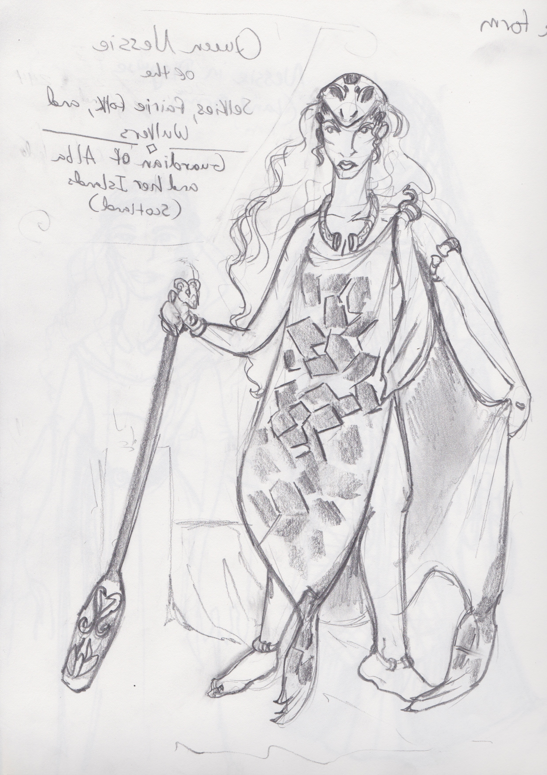
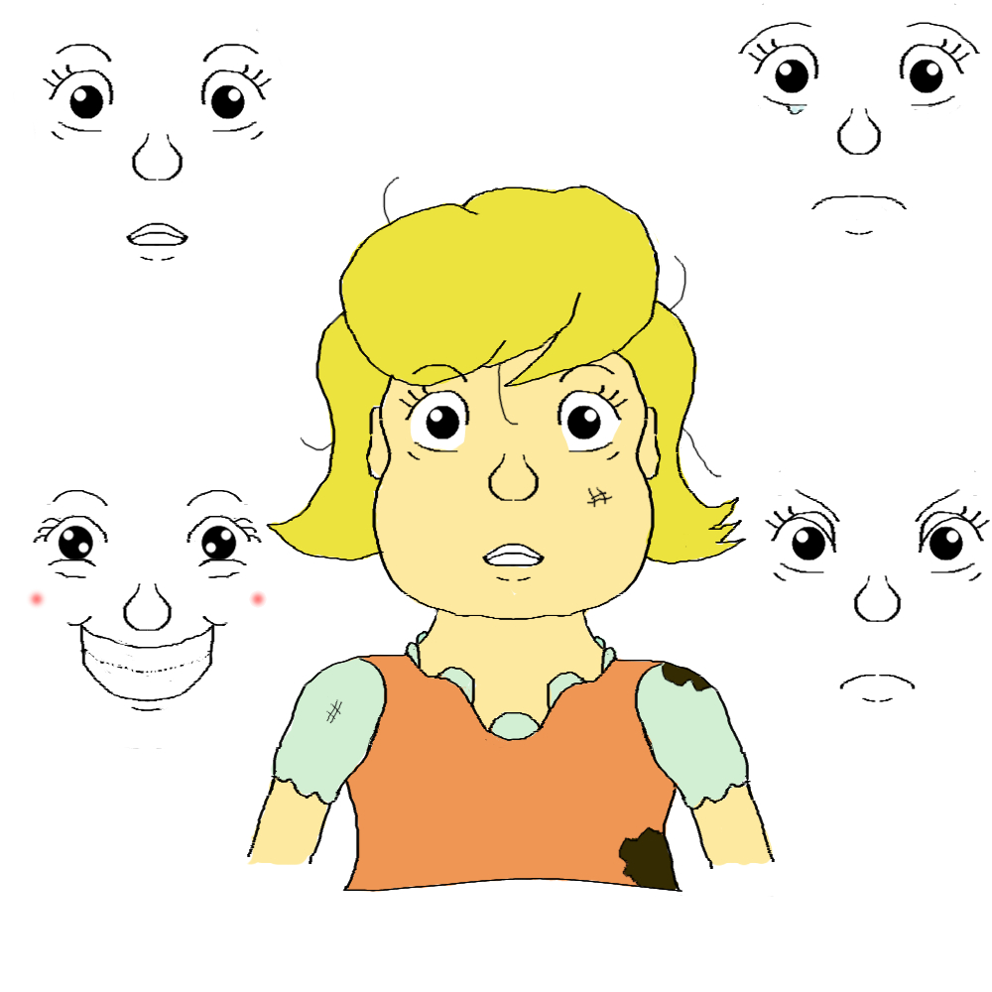
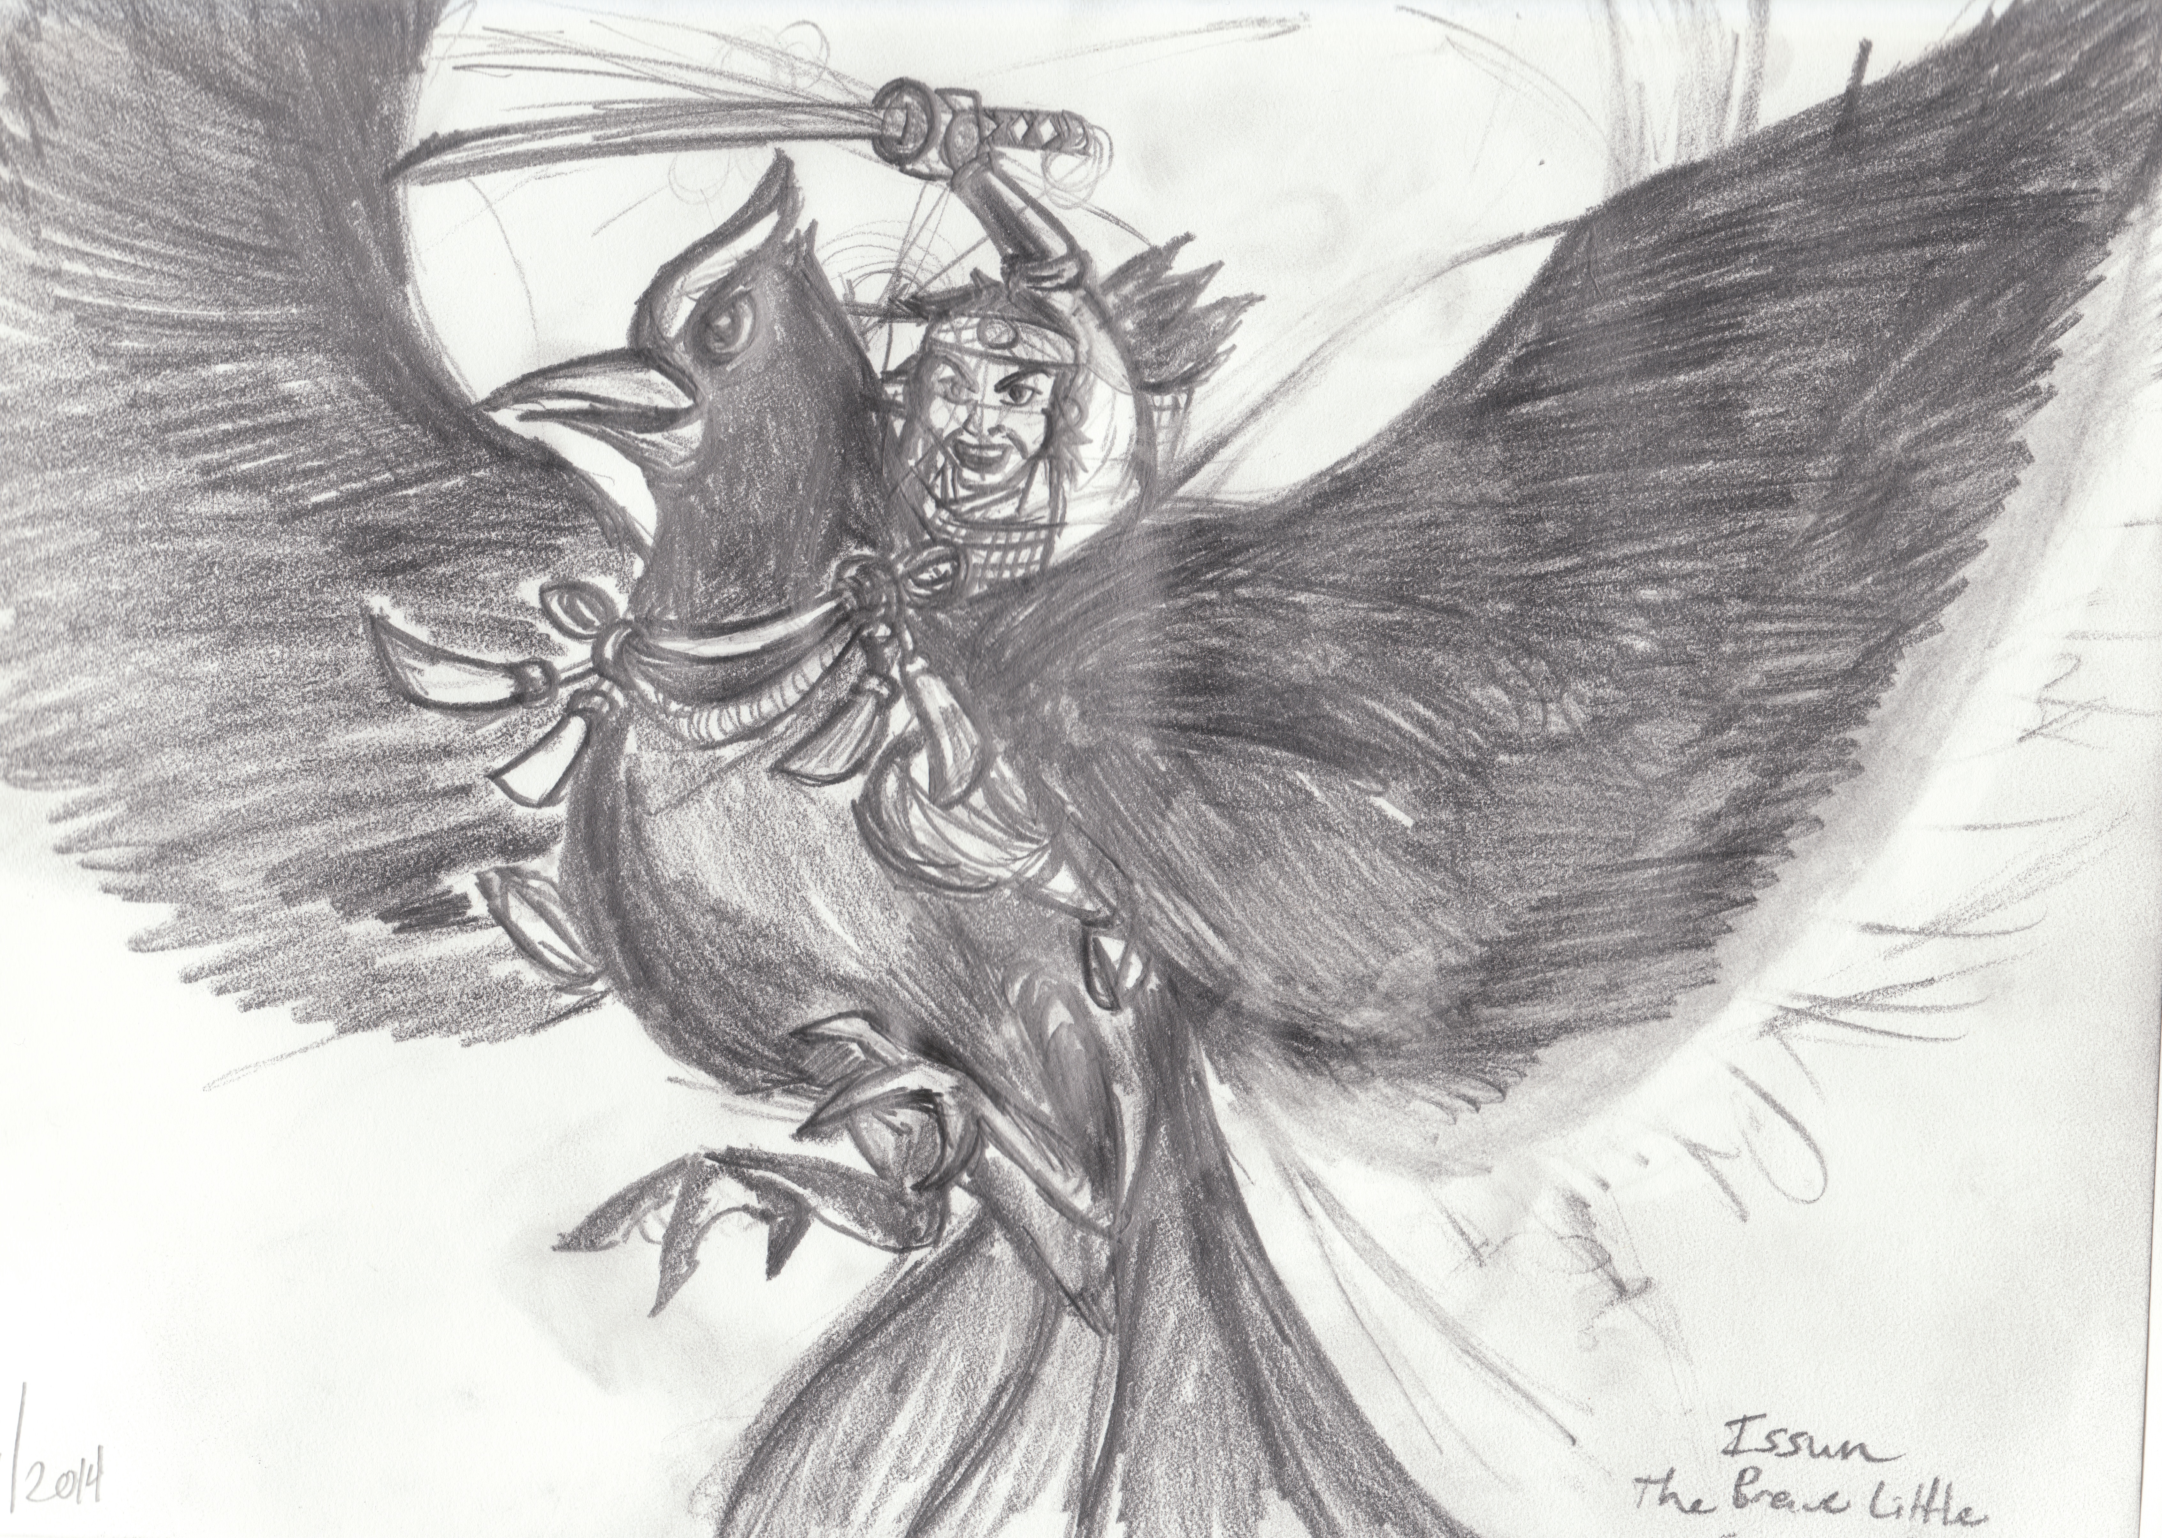
Concept Art
European Quest Giver:
Loch Ness Monster
European Quest Giver: Gretel
Asian Quest Giver: Issun

Slide 19
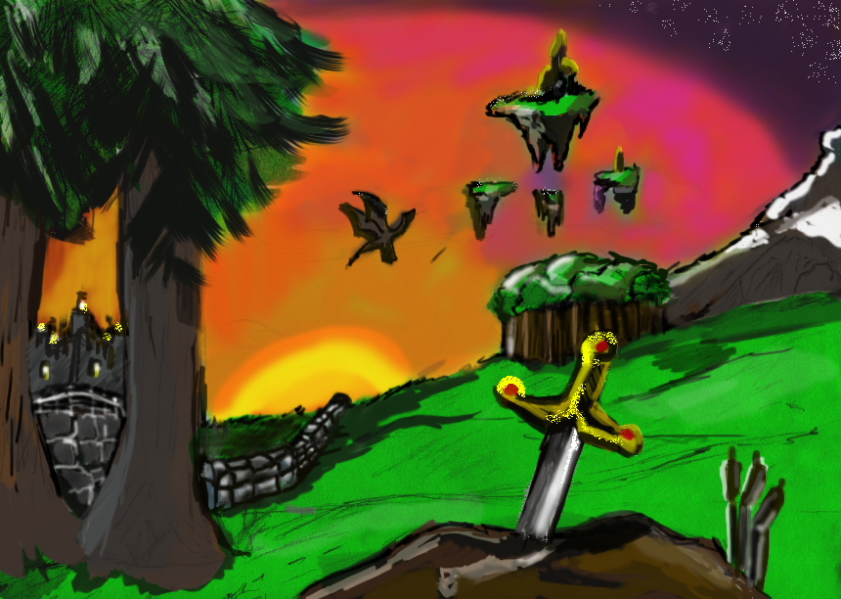

Slide 20
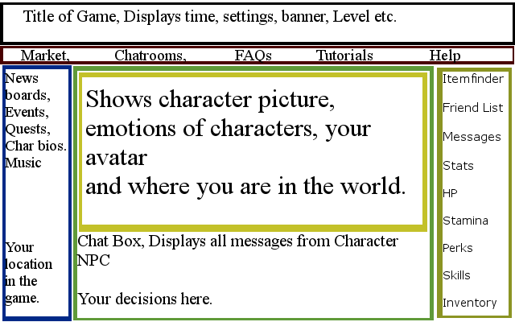
User Interface

Slide 21
Security & Safety
Disguised Employed “players”
Subscription account inlcudes:
Private Messaging
Access to all clothing/armor items
Access to Private forums
Free account includes:
No private messaging
No sharing pictures
No Web Cams
Public forums monitor by Employees
Age Restrictions by Year
Under Age (13-18)

Slide 22
Cost and Budget
All costs per tasks are estimated.
Project pre proposal (15 hours) No charge
Project proposal (6 hours) No charge
All hardware and software available should be donated or free under educational licenses or purschased
Other software will be open source and obtained at no cost.
300-900 hours – for x and y and z
300- 1800 hours – for a and b
50 hours – n, m, o
3 months (480 hours) – x integration and construction
80 hours – 3 months (480 hours) – asset integration and construction, and depends on what educational information can be leveraged from existing materials (content on websites, books, files, handouts, etc).
Total effort for Project: [7.5 months (1210 hours) – 22.8 months (3660 hours)] *
Total cost for Project: US [$500,000– $1,000,000], the lower amount is more likely.

Slide 23
Team Schedule
10 months for the x,y, and z
3 months to build A
3 months to build B
2 – 6 months after N, create M
Total project expected to require 12 to 16 months

Slide 24
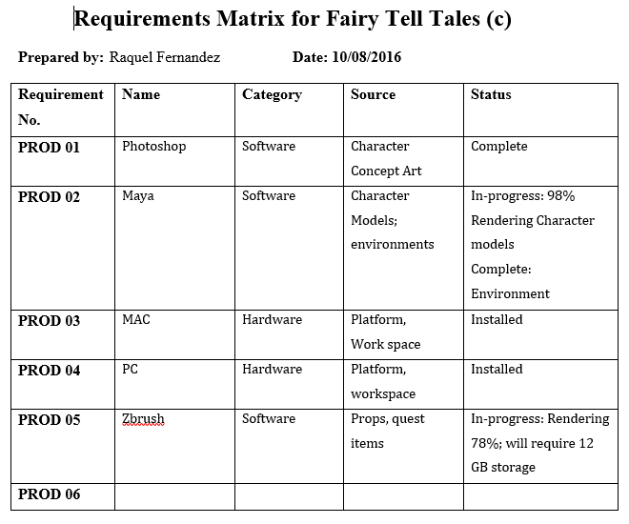
Requirement Matrix

Slide 25
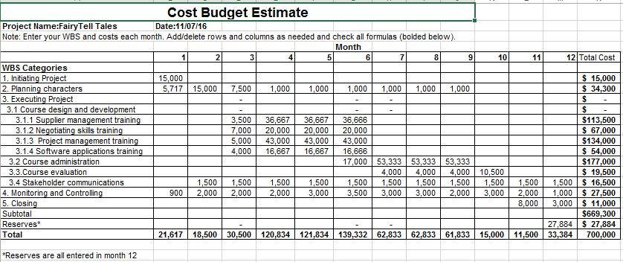
Cost Estimate Budget

Slide 26
Work Breakdown System (WBS)
Concept
Visual development
Art style
Artists; Genndy Tartakovsky, Walt Disney, Ralph Bakshi, Hayao Miyazaki, Jeff Smith
Telltale games, Blacksad Comics, Bone Comics,
Story narrative
Traditional Folklore
Legends and epics
Environment
Watercolor, three-dimensional landscape,
1.2 Storyboarding
Edit and cut scene excess scenes game
Game levels

Slide 27
Pre-production
Create schedules for animators, riggers, artists, music producers and game programmers
Set deadlines for game scenes and environment
Set deadlines for estimated completion
Production
Artists and animators
Developing game on Maya and 3D studio max
Texture maps
Send a game demo to marketing team for advertisement
Motion capture
Actors
Camera crew
Animators
Programmers
Creating game engines
Rendering polygons into 3D environments
Game mechanics and levels
Game menus and options
Music and sound effects
Orchestra
Music producer

Slide 28
Post-production
Test components
For bugs and glitches
Playability
User survey
Promotion
Television adverts
Online demo
Schedule release date
Tour conventions and Expo

Slide 29
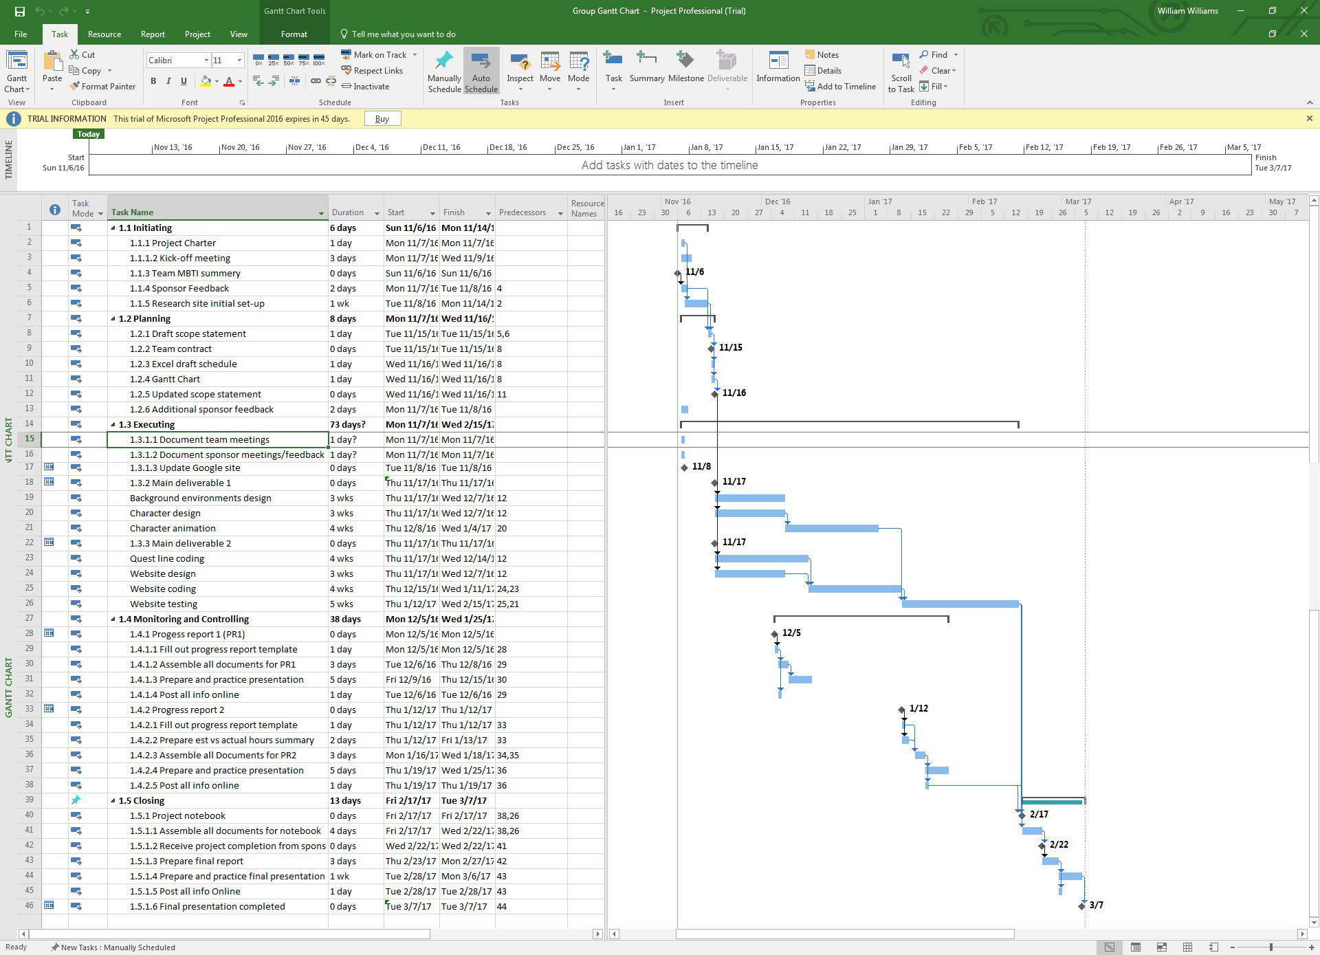
Gantt Chart

